Slide 1
LAN Talk Oct. 2024. Michael Sharwood Smith York University

Slide 2
HOME LANGUAGE
” Tu la vois, Papa!? C’est ici!”
HOME LANGUAGE “c’est quoi, ça, chéri?”
COMMUNITY LANGUAGE “Hallo! Ist hier jemand?”
(changed?)
L1 French
(changed?)
L1 French?
Language Attrition & Dynamic Schemas

Slide 3
Overview
Preliminaries
Processing Architecture in Review
Processing Principles in Review
Schemas and Internal context
Examples
Summing Up

Slide 4
Preliminaries

Slide 5
EXPLAINING ATTRITION
The Modular Cognition Framework is comprehensive in two senses:
It integrates explanations of:
how the mind represents experience with
how the mind processes experience ‘on-line’
Specific aspects of how the mind works (as in the case of language attrition) will always be treated as particular manifestations of principles that drive the whole mind

Slide 6
Comprehensive explanations concerning:
why certain once expected linguistic structures start failing to appear
what specific structural changes occur and why
what exactly happens to those structures that have ‘disappeared from view’ and why
cannot be provide by linguistic analysis alone

Slide 7
Processing Architecture in Review

Slide 8
Representations I (different types)
In the mind, all forms of knowledge are composed of (cognitive) representations (aka ‘structures’)
These fall into a number of different categories since…
the mind is organised into functionally specialised systems
8
1
2
7
6
11
3
4
10
9
5

Slide 9
functionally specialised systems
NB. ALL these systems and representations get regularly involved in language communication!
Representations are encoded following the principles of one or other of the……..
Perceptual Output Structures
P
h
y
s
i
c
a
l
S
i
g
n
a
l
s
AUDITORY
VISUAL
OLFACTORY
GUSTATORY
SOMATOSENSORY
CONCEPTUAL
AFFECTIVE
PHONOLOGICAL
SYNTACTIC
SPATIAL
MOTOR

Slide 10
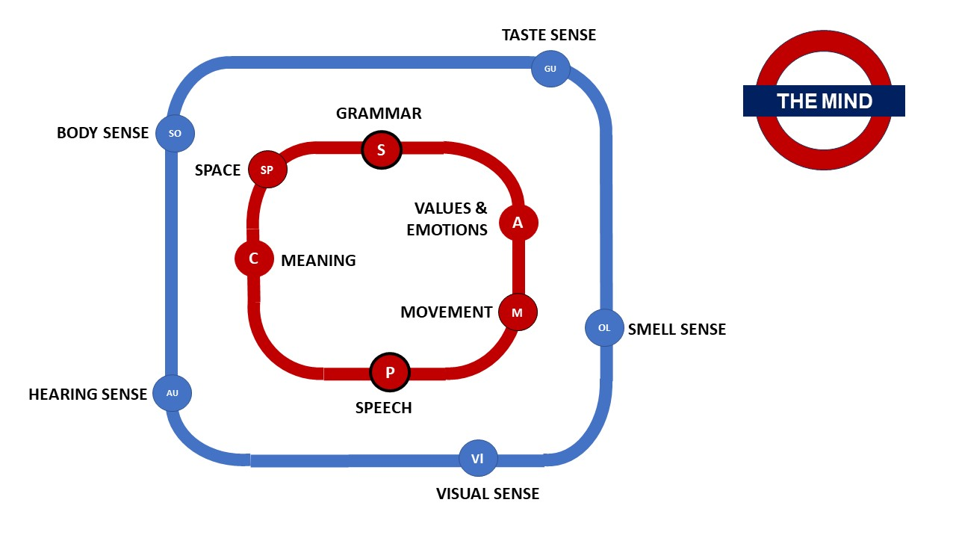
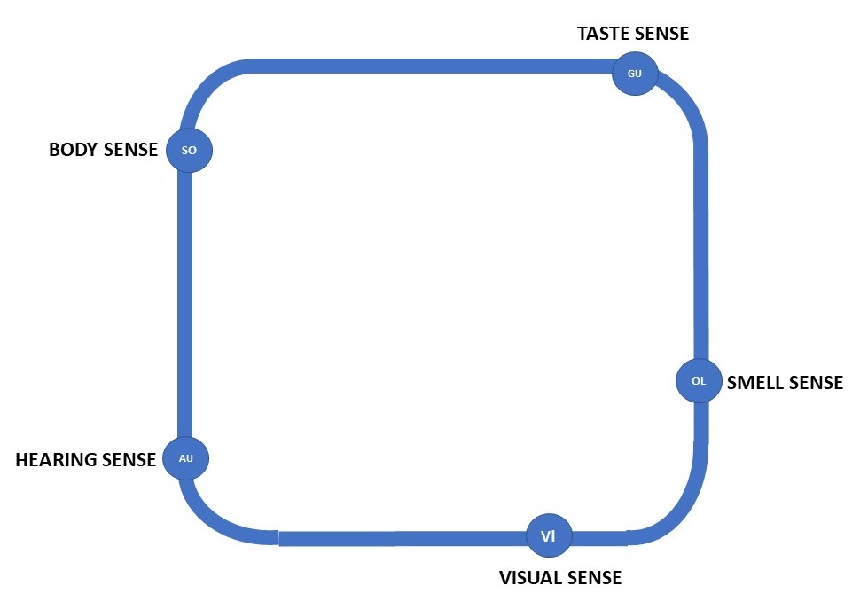
The Mind Network

Slide 11
Three notable features
G?
2
6
7
1
8
‘GENERAL COGNITIVE’ (What could that refer to?)
General Cognitive Principles exist but none of the 11 systems can be called a ‘General Cognitive System’. There is no central supervisor.
INTERCONNECTIVITY. They form a highly interconnected family of systems
WORKING MEMORY & PARALLEL ACTIVATION
What is ‘in WM’ is defined as ‘any and all CURRENTLY ACTIVATED representations’ (Activation theory of WM: Cowan et al)
Representations are (co)activated, in parallel, in, for example,(contra Cowan) conceptual WM, in visual WM, in phonological WM. etc.)

Slide 12
Representations II (construction)
The great majority of representations are created and modified in response to experience but…..
For each category a certain number of representations (primitives) are provided in advance as part of our biological inheritance.
These act as construction elements for assembling representations of a given type (visual, conceptual, syntactic…)
This Photo by Unknown Author is licensed under CC BY

Slide 13
Representations III (they are ‘sociable’)
Representations are never activated in isolation, as individual units but togther, as part of some combination
They will be activated internally with other ‘associates’ in the same system
They will also be linked externally to associates (i.e.., representations of different types) to form associative networks

Slide 14
Representations III (they are ‘sociable’)
These associative networks are called SCHEMAS
Explaining attrition will turn out to be not just about changes to individual words or grammatical constructions …
but about what plays out in large-scale schemas

Slide 15
Processing Principles
In Review

Slide 16
General Processing Principles ASSOCIATION (both internal & external)
In response to experience, associations are formed during processing:
WITHIN a particular system
Linguistic example: gender features and N in the syntactic system
BETWEEN systems
Linguistic example: /pai/ (‘pie’), in the phonological system and n in the syntactic system
S
n
P
/pai/

Slide 17
General Processing Principles Association > CO-ACTIVATION
Once associated, representations will always coactivate each other. For example, take the French word ‘pont’
gender features and N (both in the same WM)
/põ/ and N (each encoded differently in their respective WMs)
And associated with the bridge meaning (conceptual structure)
S
n
Fem
Masc
coactivate
coactivate
P
/põ/
coactivate
C
BRIDGE

Slide 18
General Processing Principles COHERENCE
During processing, the mind as a whole is driven to assemble stable and coherent representations…
both within and across systems
When representations fail to participate in a schema, the processors will use this principle to work without them.

Slide 19
General Processing Principles COMPETITION (‘Law of the Jungle’)
Activation is always a matter of degree
The greater their current level of activation, the more likely representations will compete successfully against competitors

Slide 20
Q: What dictates a representation's current activation level?
FACTOR 1:
Its current resting level
By default resting levels (and their default activation levels) will gradually DECLINE
WITH regular & frequent activation over time, a representation’s resting level will (gradually) INCREASE
Without extra help, a low activation level constitutes a HANDICAP in any competition
0
NOW COMPETING IN WM!
Regular & frequent activation is needed to maintain and increase levels
NOW ‘DORMANT’

Slide 21
Reviewing some basic facts about activation and competition
Activation always starts at its current resting level but returns to a (slightly) higher starting point (any amount of activation will produce this effect).
Any amount of inactivity causes resting levels to very gradually decline: this process is only slowed, arrested or reversed by further activation.
Long periods of inactivity means a significant decline and therefore a significantly increased competitive handicap
This can trigger adjustments in affected schemas.

Slide 22
Activation and competition in linguistic schema fragments
Competitors from both L1 and L2 will always be coactivated and compete regardless of which language ‘they belong to’ (syntactic and phonological processing is language-neutral)

Slide 23
Example: gender attrition
?
What will be the REPERCUSSIONS on observable L1 performance of a changed situation in syntactic WM?
Each processor continues to assemble coherent solutions from whatever happens to be currently available in its WM
However, a formerly dominant L1 competitor is now only weakly activated so what can happen?
S
C
chair

Slide 24
Processors’ solutions in different circumstance as suggested by research
In response to the activation of the same conceptual association (chair):
INCORPORATE NEW WINNER’ OPTION: Weakened Fem (as in L1 French ‘la chaise’) is now replaced by the ‘new winner: e.g., Masc (L1 outcome now‘ *le chaise’ as in L2 ‘der Stuhl’ (CLI)
RANDOM /DEFAULT OPTION: The specific gender feature becomes randomly assigned or some standard default gender option emerges (e.g. Masc) (as observed in diachronic change)
ZERO RESPONSE OPTION: Where the ‘stronger’ L2 has no grammatical gender, exposure to L2 evidence provides no obvious structural options to house L1 grammatical gender features. (No obvious CLI)
See, for example, Lohndal & Westergaard 2021

Slide 25
32 minutes so far
Schemas And Internal ‘Context’

Slide 26
Being part of some schema is the natural state for any (activated or dormant) representation
S
C
P
Au
Vi

Slide 27
However, examples so far have been very small schema fragments! In practice, schemas extend across many more systems with varied consequences for observable language performance
S
C
P
Au
Vi

Slide 28
We have now arrived at the important second factor that, at any given moment, always influences a representation’s activation level
FACTOR 2
A representation’s ‘internal context’

Slide 29
DEFINITION of INTERNAL CONTEXT
From a linguist’s point of view, it is:
All current activity that taken together is influencing linguistic processing. Effectively this refers to anything in the currently activated (total) schema that is affecting the outcome (winners & losers’) of syntactic and phonological processing
S
?
C
?
P
?
Au
?
Vi

Slide 30
EXAMPLES (Internal Context)

Slide 31
INTERNAL CONTEXT: SIMPLE EXAMPLES BASED ON PREVIOUS PRESENTATIONS & ARTICLES
Heritage language children: many variants, e.g.:
At Home (version 1: happy at home).
At Home (version 2: less happy with home).
At School (happy at school).
Any bilinguals
Spontaneous code-switching
Crosslinguistic influence in general

Slide 32
SCHEMA CONTENT: EXAMPLES
Bilingual heritage language children at Home Regularly and frequently co-activated:
conceptual representations associated with home environment, specific goals, self concept (identity etc.), specific people, language, cultural home events, home food, etc.
affective (value, emotional) representations associated with all of the above
perceptual representations (sights, sounds, tastes, smell, feel etc.)
Syntactic and phonological representations.

Slide 33
SCHEMA EXAMPLES
For the child currently experiencing the home environment, the combined effect will be:
raised activation levels in all representations associated with that regular experience…
including any associated linguistic representations

Slide 34
GU
SO
AFFECTIVE ASSOCIATIONS
(emotional associations, negative and positive associations)
S
SP
A
C
M
OL
P
AU
VI

Slide 35
GU
SO
S
SP
CONCEPTUAL ASSOCIATIONS
(Meaning associations)
A
C
M
OL
P
AU
VI

Slide 36
GU
SO
S
SP
Home Language & Community Languages coactivated
Syntactic and phonological associations
A
C
M
OL
P
AU
VI

Slide 37
COMBINED CONCEPTUAL AFFECTIVE,
LINGUISTIC
SCHEMA’

Slide 38
GU
SO
S
SP
A
C
M
OL
P
AU
VI

Slide 39
INTERNAL CONTEXT CHANGES ALL THE TIME: SCHEMAS ARE DYNAMIC!
Example: as the child moves towards and into the SCHOOL environment where the language of the community is used
The internal context of ongoing linguistic processing shifts accordingly
New biases emerge with many associations losing their temporary boosted activation levels while the activation levels of other representations are simultaneously raised
all without conscious intervention
morphing in milliseconds, seconds, minutes, etc.

Slide 40
Summing Up

Slide 41
FINALLY, six take-home messages and some observations:
Language attrition research describes and analyses what happens. As to WHY it happen, explanations will have to be developed involving ‘mind-wide’ influences not just those subsections of a schema that are more obviously and directly language- related’
Because schemas are dynamic, the activation history of any representations continually changing.
This means that, in the background, the resting levels of some representations are gaining, while the levels of others are declining. Both events happen whether or not the effects are observable in performance and whether or not they are easily classifiable as attrition.

Slide 42
At any given moment, the processors will respond immediately to what happens to be in their current WM in line with the drive for coherence
Attrition effects are not only due to the decline in resting levels but also about subsequent structural adjustments.
Since every individual mind builds and activates its own internal representations of reality, any changes will be marked by individual variation (posing quite a challenge for research)

Slide 43
Eight observations on topics in the atttrition literature
In the light of the MCF whole-mind approach to attrition, the Glen & Hicks (2020) definition of attrition as: ‘potentially enduring modification to morphosyntactic properties of an end-state grammar under linguistic pressure’ turns out to be inadequate.
A model that defines attrition without considerations of global processing hampers its explanatory power.
The ‘pressure’ is not confined to the linguistic system(s) alone but also comes from the internal context: ‘grammar-internal’ changes will always conform to grammar-internal principles but changes may be imposed upon them by external pressures (and the MCF can show why and how)

Slide 44
‘Recovery’
Structures and their associations which appear to have dissolved completely may still be present but with much reduced resting levels. This means attrition can be reversible.
The recovery process would be different from acquisition at least in the sense that the attrited structures were never actually extinguished.
Recovery would be defined in terms of a restoration, in observable performance, of the original representations and associations (the ‘Phoenix Illusion’?) due to renewed exposure and reactivation.

Slide 45
‘Dominance’
Finally with regard to language ‘dominance’ in the literature usually refer to whole language systems (e.g. L1, L2. L3, or dialects),
Dominance in the MCF is explained in terms of given representations in schemas. It is often a dynamic, transitory phenomenon. This adds more finely-grained distinctions to more general notions of dominance.

Slide 46
The End

